Slide 1
Open Science in Bioinformatics
Caleb Kibet
Notes:
How do we add logos?

Slide 2
What to expect...
What is Open Science
Why Open Science
Open Science Taxonomy
Open Science Tools
Open Science in Bioinformatics

Slide 3
What is Open Science ?

Slide 4
Open Science is the practice of science in such a way that others can collaborate and contribute, where research data, lab notes and other research processes are freely available, under terms that enable reuse, redistribution and reproduction of the research and its underlying data and methods.
(https://www.fosteropenscience.eu/foster-taxonomy/open-science-definition )
Notes:
Science [Definition] : the intellectual and practical activity encompassing the systematic study of the structure and behaviour of the physical and natural world through observation and experiment.

Slide 5
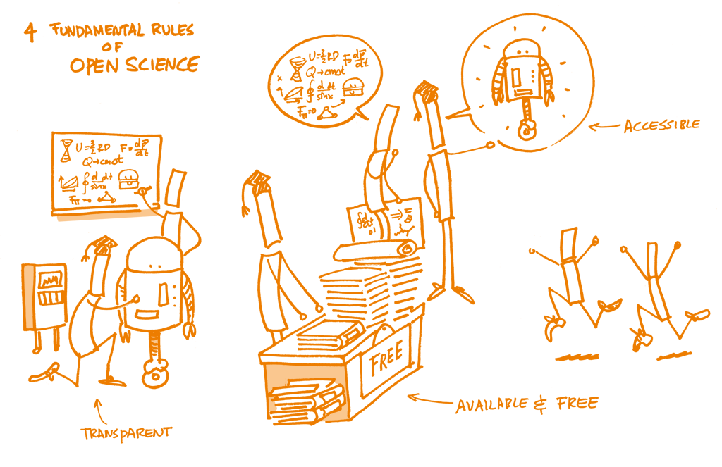

Slide 6
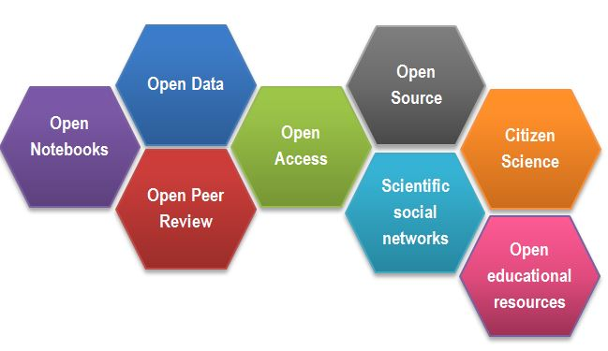
(https://www.fosteropenscience.eu/content/what-open-science-introduction)

Slide 7
Why Open Science ?

Slide 8
"When all researchers are aware of Open Science, and are trained, supported and guided at all career stages to practice Open Science, the potential is there to fundamentally change the way research is performed and disseminated, fostering a scientific ecosystem in which research gains increased visibility, is shared more efficiently, and is performed with enhanced research integrity."
Open Science Skills Working Group Report (2017)

Slide 9
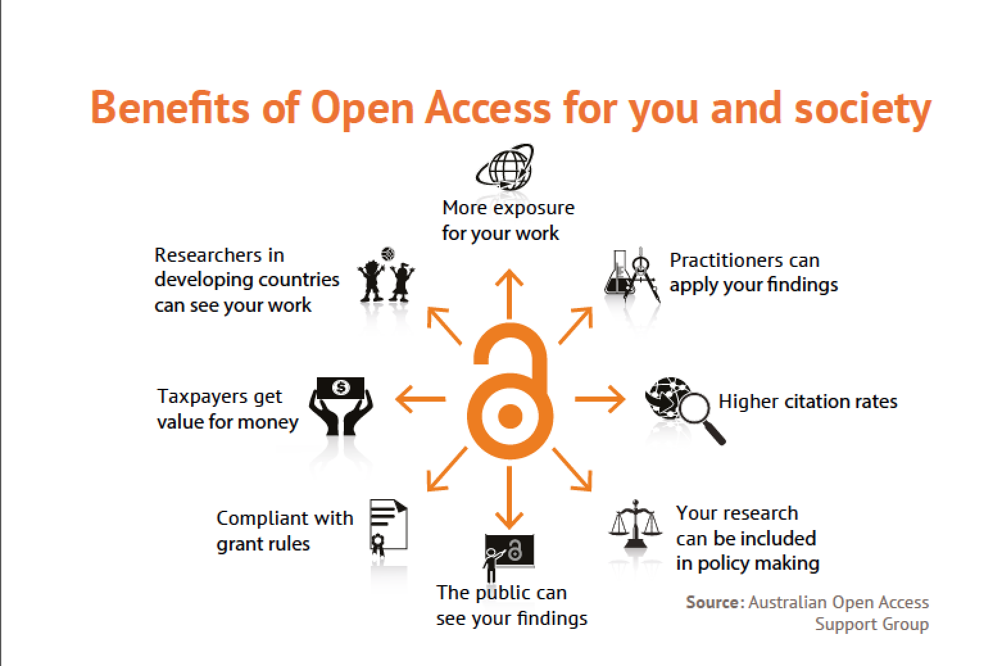
Notes:
Potential collaborators can see our work

Slide 10
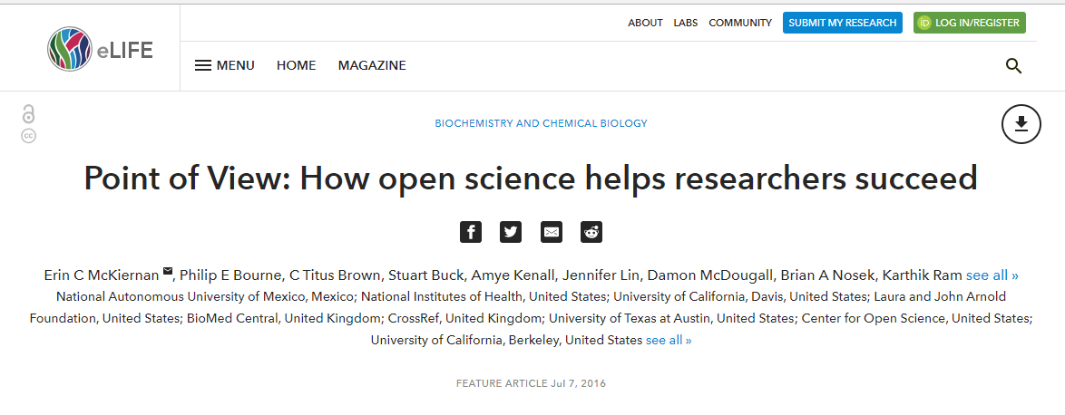

Slide 11
Open Science is good for the researcher...
Increased quality of research from reduced errors and fraud due to wider scrutiny and evaluation brought about by transparency
Increased opportunities for both local and global participation in research
Faster transfer of knowledge required to solve problems
Fosters innovation which produces new products and services
Improves productivity and research output due to reduced duplication
Promote awareness among citizens which improves willingness in participation in experiments and data collection.
Notes:
Talk about the benefits of Open Science to the Researcher and to Scientific Community
Fosters innovation which produces new products and services, a results of faster re-use of data and research results
Improves productivity and research output due to reduced duplication, and cost of reuse and transfer of data and more research from the same data.

Slide 12
Open Science Taxonomy

Slide 13
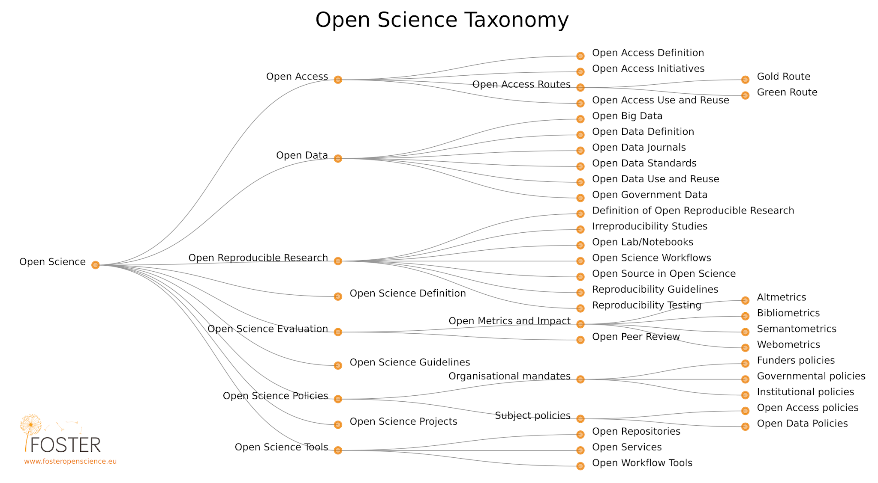
Notes:
Open science is vast, we will only cover areas relevant to our setting.

Slide 14
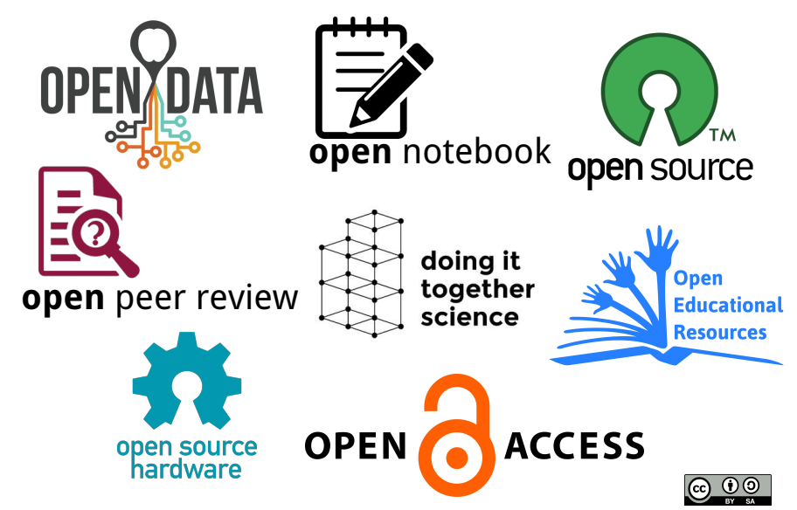


Slide 15
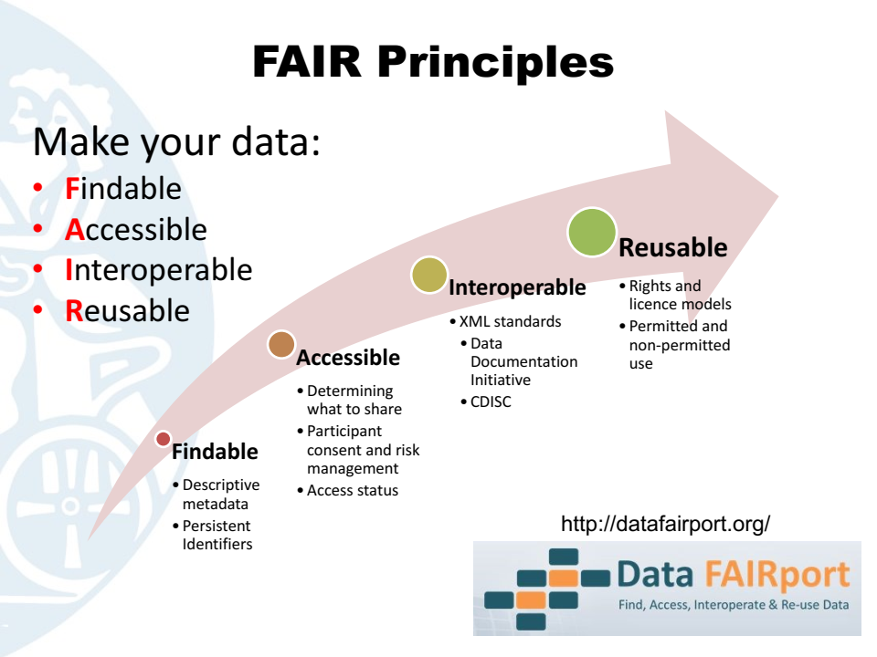
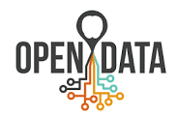
Your Open Data should adhere to...
Notes:
Open data means more hands at work, more brain power and faster innovations
Open data creates a culture of transparency and reproducibility
Adhering to FAIR principles make the above possible

Slide 16
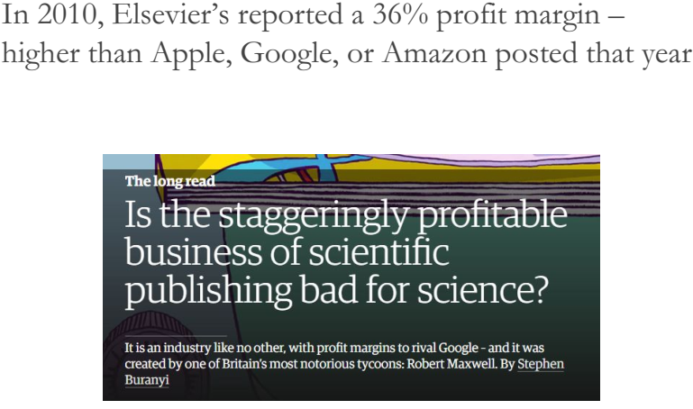
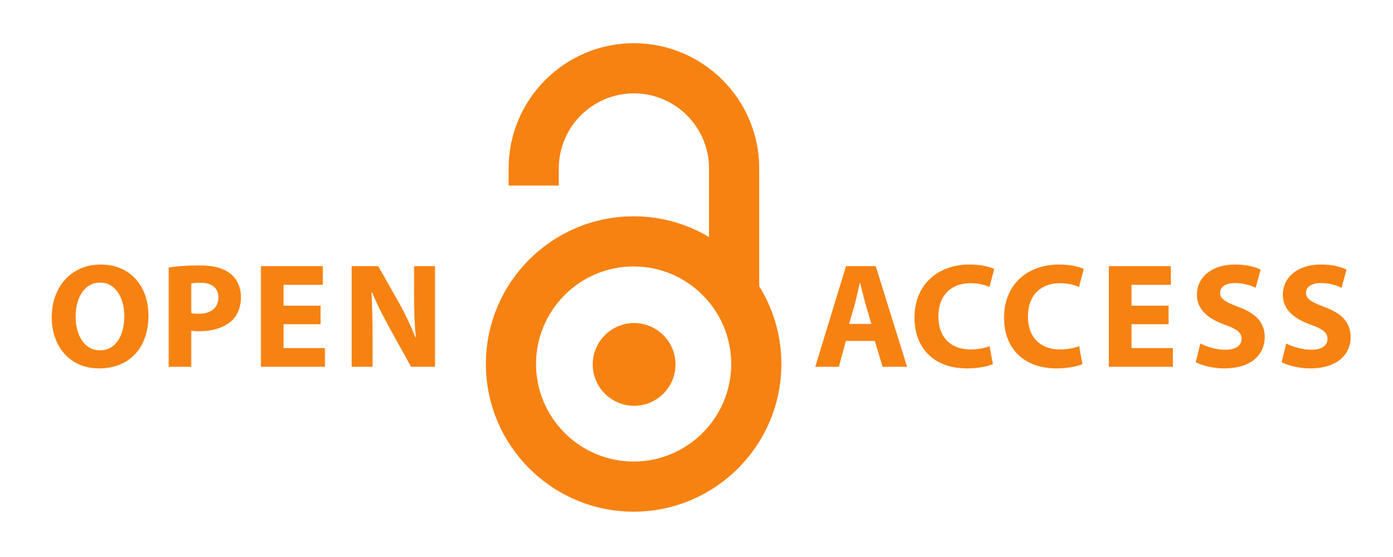
The monster of Paywalls and Impact Factors...
Notes:
This is a hot topic. Some consider Paywalls and Impact factor to be bad for science. What is our opinion? Should we care about impact factor? What other metrics can be used to measure research output? If the research has been publicly funded, why should the public still need to pay to access?

Slide 17
“When a measure becomes the target, it ceases to be a good measure”
--Goodhart's Law
Notes:
Is publishing in high Impact factor Journals target or doing great science?

Slide 18
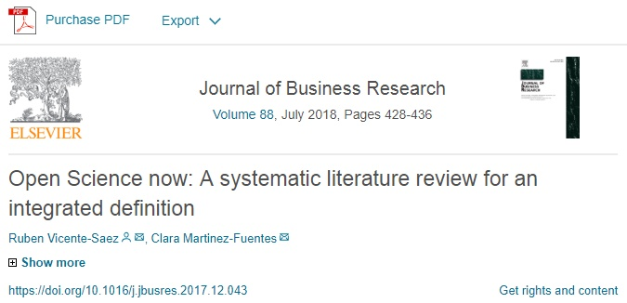
The Irony...
“Open Science is transparent and accessible knowledge that is shared and developed through collaborative networks”
Notes:
This paper, rightly defines open science but fails to be open...

Slide 19
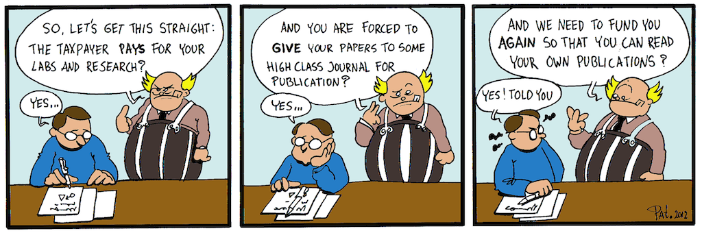
The Paper is the advertisement...
But...
by Patrick Hochstenbach
CC-BY
Notes:
Is the cost of open access an impediment to open science, especially for researchers in developing countries?

Slide 20
“An article about computational results is advertising, not scholarship. The actual scholarship is the full software environment, code and data, that produced the result.”
Buckheit and Donoho (1995)
Notes:
And this is where we begin…

Slide 21
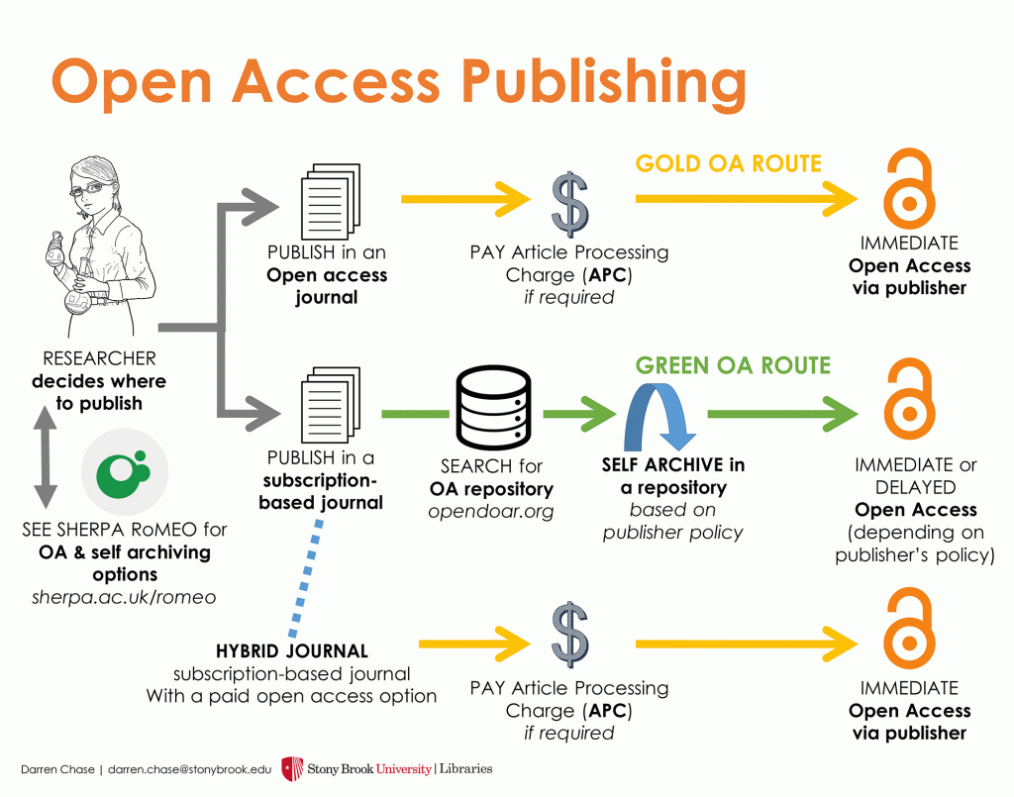
What are your options?
So, even with closed Journals, you can still be Open:
Preprint
Postprint
Notes:
When you cannot publish open access, you can make your publication accessible as a preprint or postprint...

Slide 22
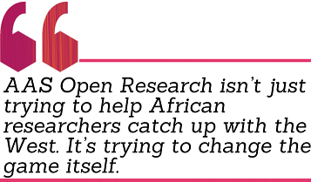


Some Great Options...
Journals with open access and open review:
F1000Research
The AAS Open Access Journal
Wellcome Open Research
eLife

Slide 23
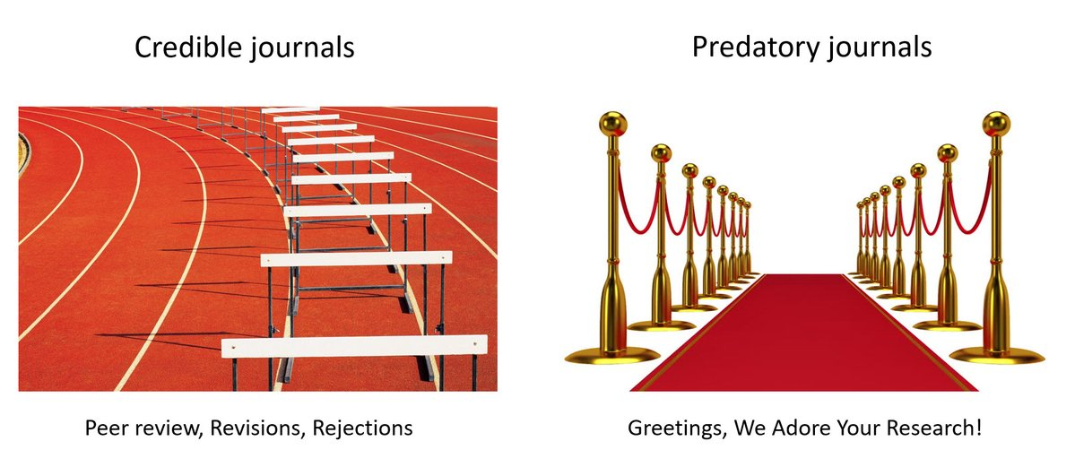
But avoid Predatory Journals...
LowCostOpenAccess

Slide 24
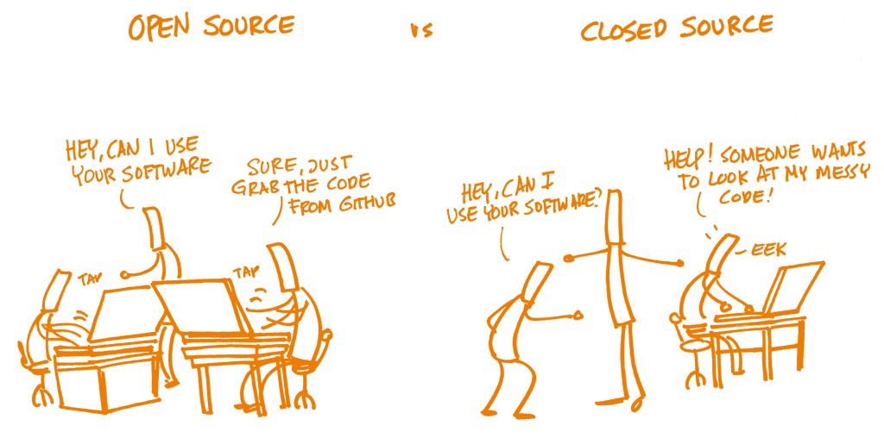
Code is the Scholarship...
Notes:
This means, that even with closed access publishing, you can still find ways of making the scholarship easily accessible -- via open source.

Slide 25
Open Science Tools in Bioinformatics

Slide 26
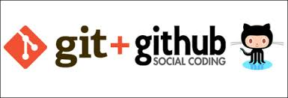
Git and GitHub
Git is a Version Control System.
Helps to keep track of the entire history of things that you are working on.
Facilitates collaboration on projects
GitHub is a hosting service for Git Repositories
Web-based service for version control and online collaboration
The social networking site for developers
Used to build a portfolio and get noticed by potential recruiters
Notes:
We may not learn much on this, it is something good to explore.
Gitlab and Bitbucket

Slide 27
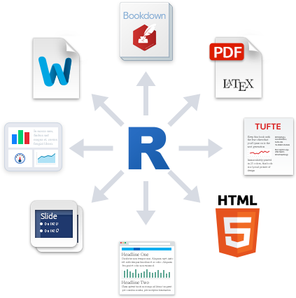
RMarkdown
Provides an authoring framework for data science
It can be used to save and execute code
As well as generate high quality and reproducible reports or presentations that can be shared with an audience
It has built-in support for HTML, PDF, MS_Word, RTF, Github, ODT etc
Notes:
We’ll learn on this in our upcoming lectures, which will mostly be hands-on.

Slide 28
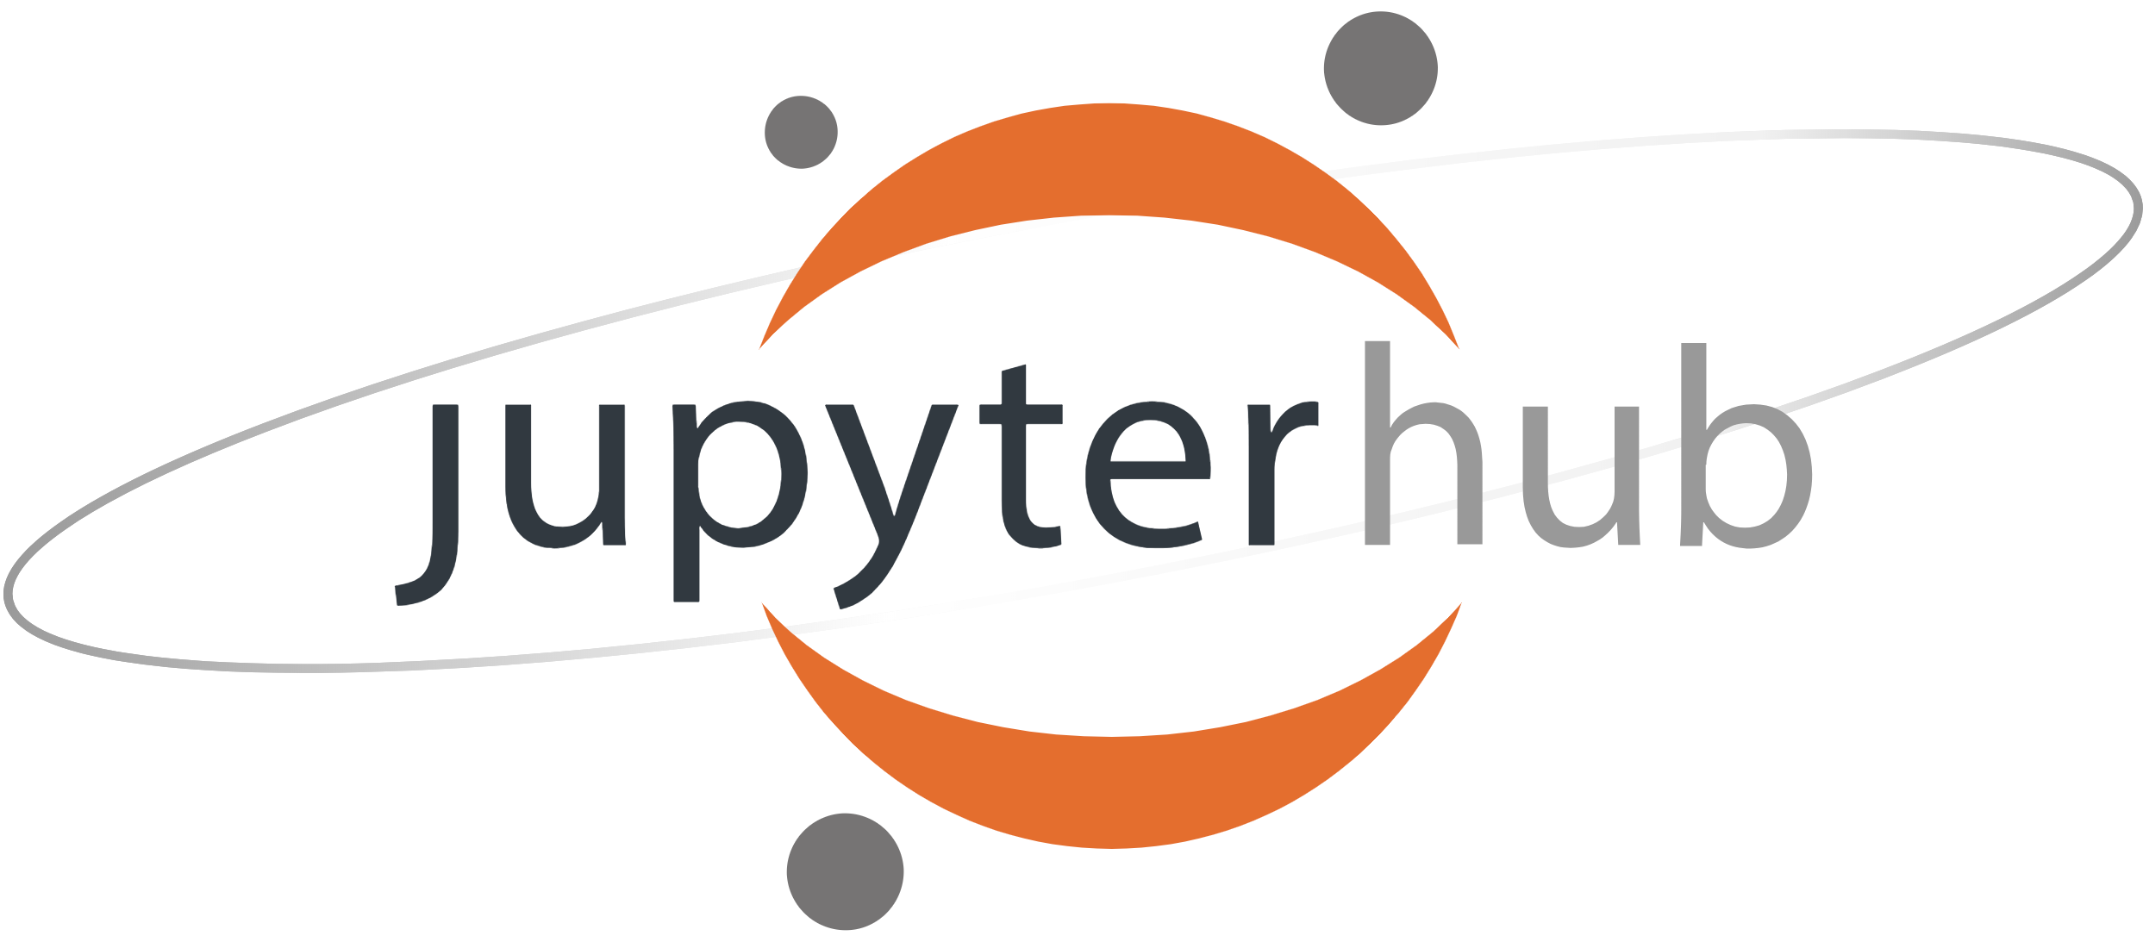
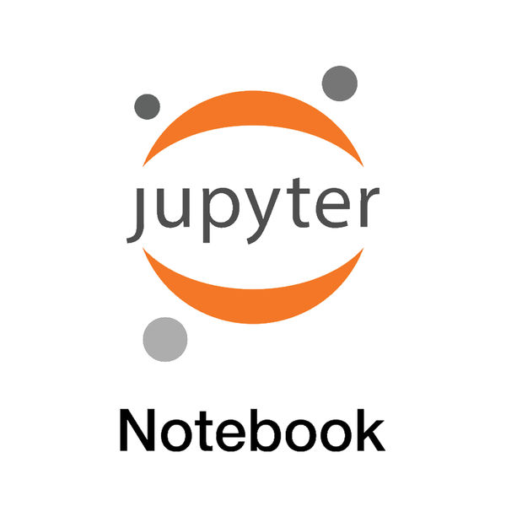
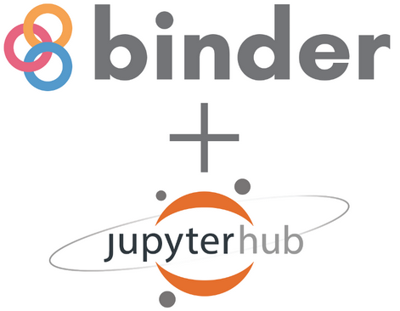
Literate Programming: Jupyter Notebooks...
Open web application for creation and sharing of documents with live code, equations, visualization
Notebook documents are human-readable and can contain analysis description, results as well executable code that can be run to perform data analysis.

Slide 29
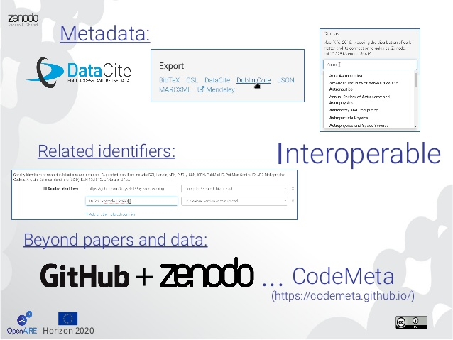
Zenodo
Notes:
Wikipedia: Zenodo is a general-purpose open-access repository developed under the European OpenAIRE program and operated by CERN.^{[1][2]} It allows researchers to deposit data sets, research software, reports, and any other research related digital artifacts. For each submission, a persistent digital object identifier (DOI) is minted, which makes the stored items easily citeable.

Slide 30
Data repositories
Zenodo - is an open access research data repository that provides a place for researchers in any field to deposit datasets up to 50 GB. It has an integration with GitHub to make code hosted on GitHub citable.
Figshare - is an online digital repository where researchers can preserve and share their research output i.e. figures, datasets, images and videos.
Dryad - is a curated a general-purpose repository that makes the data undisclosed in scientific publications discoverable, freely reusable and citable
Dataverse - is an open source web application to share, preserve, cite, explore and analyze research data. Dataverse repository hosts multiple dataverses

Slide 31
How I’ve practiced Open Science...
F1000: https://f1000research.com/articles/4-1429/v2
Jupyter: https://github.com/kipkurui/MARS_Evaluation/blob/master/MARS_Evaluation/Complete_Analysis-MARS_Evaluation.ipynb
BioRxiv: https://www.biorxiv.org/content/early/2016/11/14/065615
Zenodo: https://zenodo.org/record/46440#.WweEXe6FOM8

Slide 32
Open Science in Bioinformatics

Slide 33
Bioinformatics is becoming a Data Science, therefore, Open Science Tools should be adopted.

Slide 34
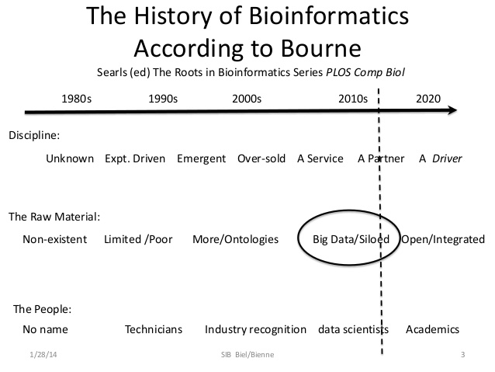

Slide 35
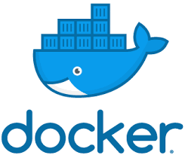
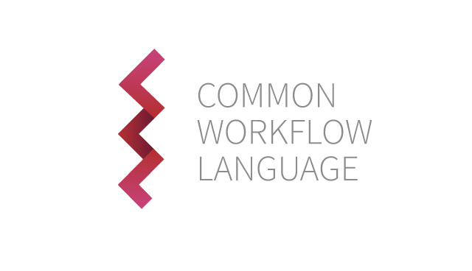
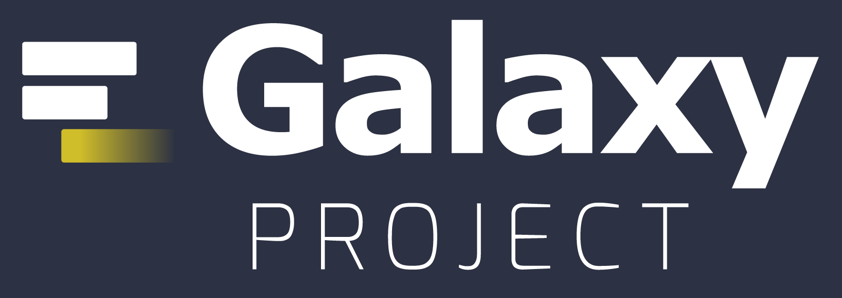

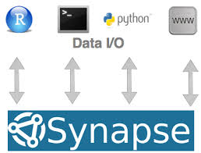

But some specific ones exist...
Singularity

Slide 36
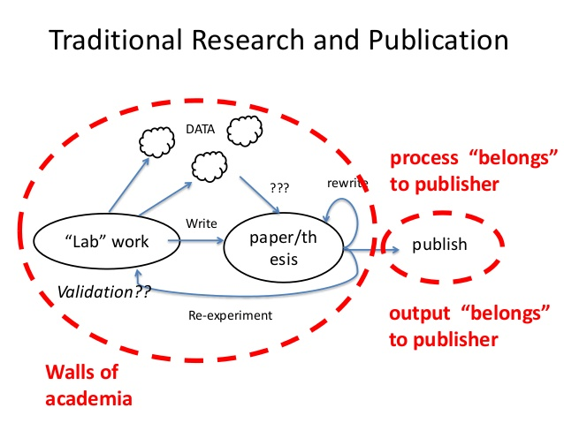

Slide 37
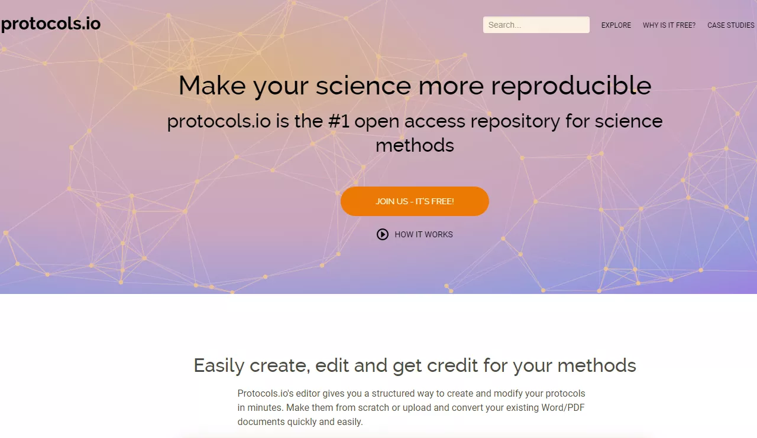
There is Protocol.io for experimental biologists

Slide 38
To learn more about Open Science...
Open Science Handbook: https://open-science-training-handbook.gitbooks.io/book/content/
What, exactly, is open science?: http://openscience.org/what-exactly-is-open-science/
How open science helps researchers succeed: https://elifesciences.org/articles/16800#abstract

Slide 39
Our hope is that...
“Future generations [will] look on the term “open science” as a tautology – a throwback from an era before science woke up.
“Open science” will simply become known as science,
and the closed, secretive practices that define our current culture will seem as primitive to them as alchemy is to us.”
-- Brian Nosek and Chris Chambers
Notes:
In the end, this is our desire.

